Slide 1
C TRACKER
Team 2
GOKUL R
ALLEN MATHEW VARGHESE
ASHWIN SABU
ABEY SAJI KURIAN

Slide 2
INTRODUCTION
COVID-19 has become a worldwide pandemic and all are working hard to get a vaccine on it. By that time, prevention and care has to be given crucial importance. We noticed that most cases were reported through contact and decided to work on something “contactless”! Currently most shops are using manual mode of registration which is a cause for spread. We chose to design a more secure and user-friendly system where both temperature detection and customer registration is being performed on a go! Moreover it’s more on the budget side which encourages more shops to adopt this system and thereby ensure safety for both customers and staffs.

Slide 3
ABSTRACT
The world-wide pandemic Covid-19 is spreading reportedly through contact. The main threat of health authorities is to make a flowchart. The system of noting details of visitors to the shop is also a reason for spread. So we are here with an alternative way. In our proposed system, we are creating a system in which temperature is being verified and if normal, a QR code is being displayed. Then this code is being scanned by the web application so as to store the entry time of customer along with the shop details . Similarly the exit time is also being recorded as the customer confirms his exit via button. Through this, if a person is found positive it would be easier for the authorities to frame his route map and thereby restricting its spread to an extend!

Slide 4
Current Existing Project
Non-Contact digital thermometer (Now a days seen at the entry point in shops).
Customer visit in shop is noted by entering their mobile number at the cash counter or is recorded in a pen and paper format at the entry point.

Slide 5
Advantages Over Existing Once
Main advantage is that there need not be any person to check the temperature as a proximity sensor is placed in order to identify a person is present or not.
Here the entry time and exit time is stored to the database by the customer itself, there need note be a person arranged at the reception to note down the customer details.
With the entry time and exit time , tracking becomes more easier.

Slide 6
Module Description
1 . Temperature detection
The MLX90614 IR Thermometer Sensor associated with the Ultra-sonic sensor emits ultra-sonic radiations within a particular range. If any object is detected within the PIR’s range, object detection takes place and the MLX90614 sensor gets triggered resulting in the calculation of temperature. This sensor has an inbuilt ADC converter which gives the digital value to the Arduinomega2560. The real-time measured value is compared with the normal value which has been programmed in the micro-controller.

Slide 7
Module Description
2 . QR Code Generator and Scanner
Here as the shop registers in the web application, a unique QR code is been generated for them along with the shop name. This generated QR is displayed on the LCD panel, so when the customer scans the QR code the shop name is stored along with the customer credentials to the database to keep a record that he had visited the shop.

Slide 8
Module Description
3 . Entry and Exit Pass
After the code validation the data is added into the data base and an entry pass is provided .When the customer confirm the exit an exit pass is shown .While clicking on exit button, the exiting the time will be stored in database. Similarly entry time is also stored when the pass is provided.

Slide 9
Module Description
4 . Information Retrieval
If someone is tested positive then his/her records can be retrieved via registered mobile number(PRIMARY KEY).
Since each customers time period is being recorded other customers who were present can also be found!

Slide 10
DIAGRAMS
1.USE CASE DIAGRAM
2.ER DIAGRAM
3.ACTIVITY DIAGRAM

Slide 11
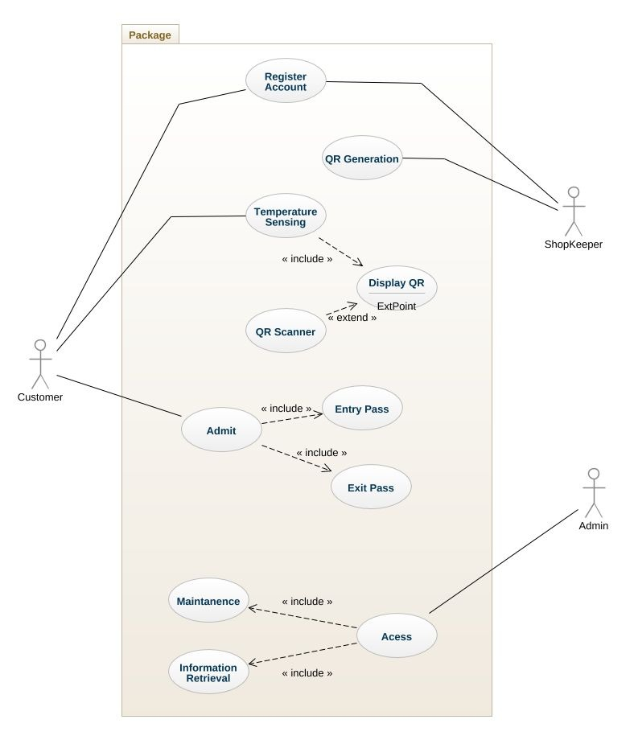

Slide 12
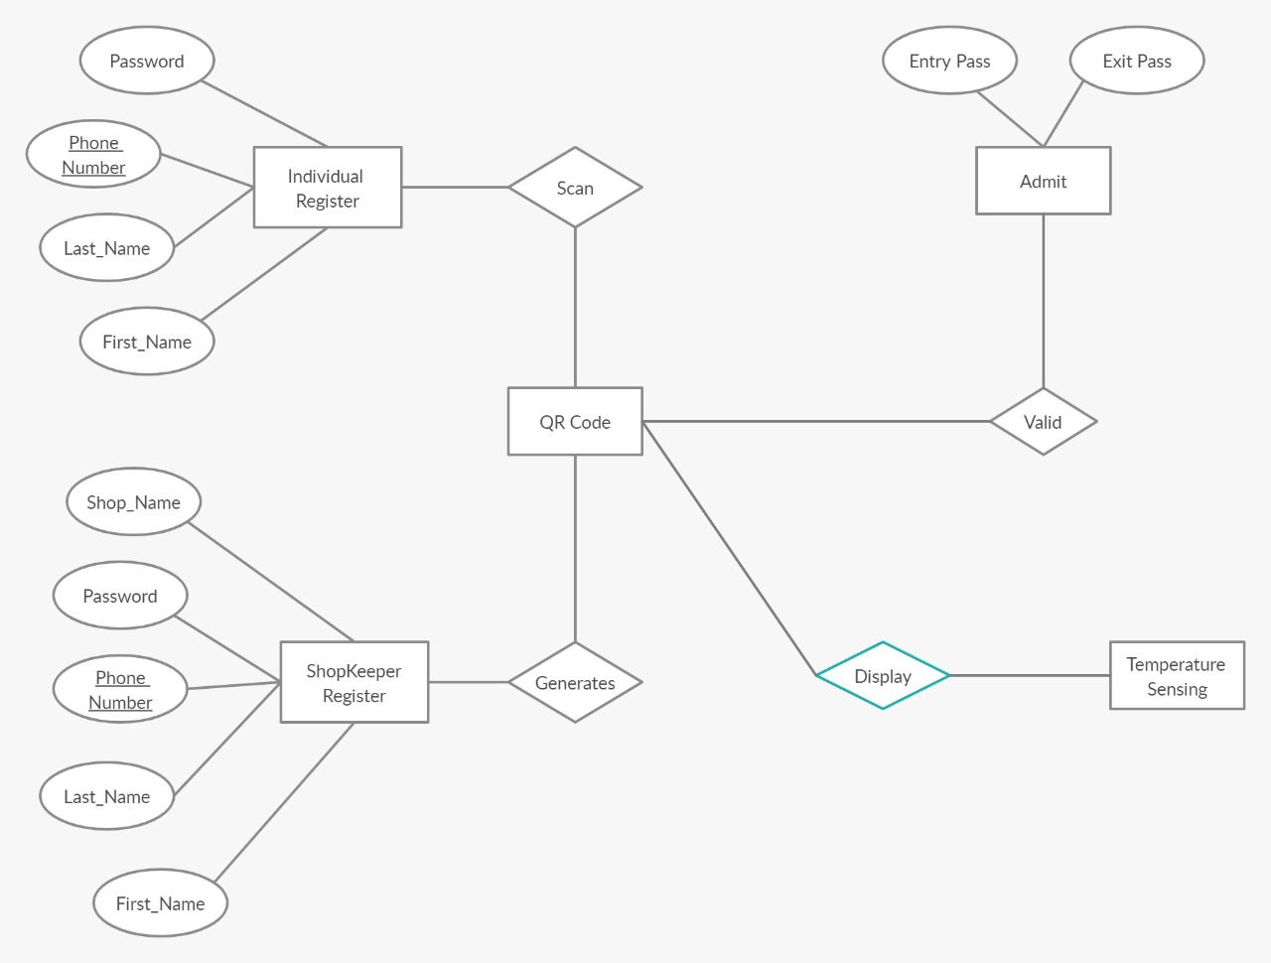

Slide 13
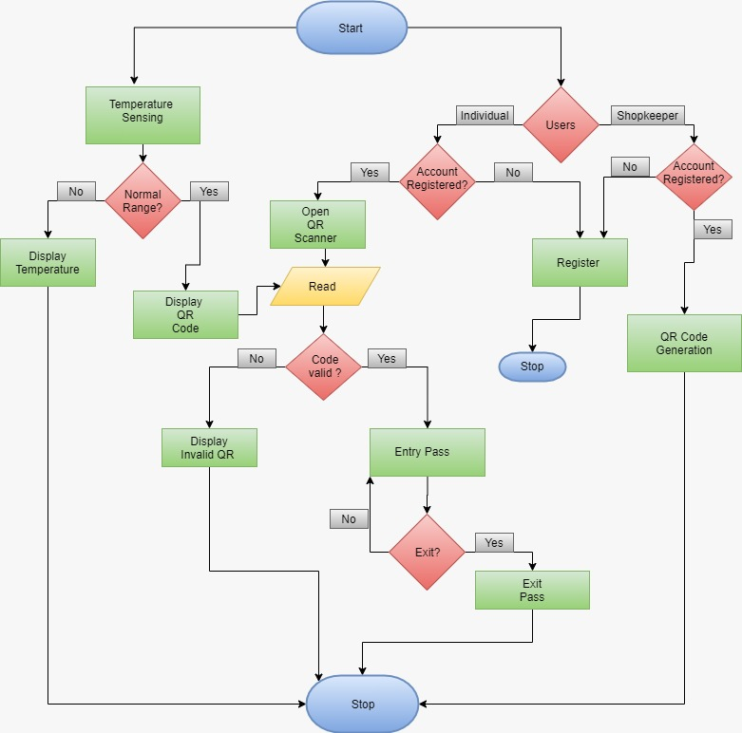

Slide 14
Application
● An alert is set to the shopkeeper if temperature is exceeded.
● Spread of the disease can be prevented to an extend.
● It helps in tracking the customer if he/she is tested positive and route map can be generated more efficiently.

Slide 15
CONCLUSION
This particular system can definitely create a more secure and safe experience during registration process. Here staffs and securities are not at all in risk, history backup is assured and moreover it’s a hassle-free technology which will contribute well to the “break the chain campaign”. We hope that this could become of great use in this pandemic period.

Slide 16
References
Md. Asaduzzaman Miah, Mir Hussain Kabir, Md. Siddiqur Rahman Tanveer and M. A. H. Akhand, “Continuous Heart Rate and Body Temperature Monitoring System using Arduino UNO and Android Device”, International Conference on Electrical Information and Communication Technology Volume 10,2015.
SHA Chunfang (Yancheng Teachers College,Yancheng,224002,China);MLX90614 IR Thermometer and Its Application[J];Modern Electronics Technique;2007-22
Dudheria, Rishabh. "Evaluating Features and Effectiveness of Secure QR Code Scanners." 2017 International Conference on Cyber-Enabled Distributed Computing and Knowledge Discovery (CyberC). IEEE, 2017.
Bates, Cary Lee, Paul Reuben Day, and John Matthew Santosuosso. "Ordering of database search results based on user feedback." U.S. Patent No. 6,873,982. 29 Mar. 2005.
A. Maier, A. Sharp and Y. Vagapov, "Comparative analysis and practical implementation of the ESP32 microcontroller module for the internet of things", 2017 Internet Technologies and Applications ITA 2017 - Proceedings of the 7th International Conference IEEE, pp. 143-148, November 2017.

